Slide 1
Time Series Analysis
Overview
Dec 2018
Joel Patterson
jpatter@us.ibm.com

Slide 2
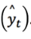
What is a Time Series?
Data points recorded at consistent time intervals
Each data point in the series is dependent on the previous data points
A time series has time (t) as an independent variable (in any unit you can think of) and a target dependent variable (y_{t}). The output of the model is the predicted value for y at time t
Notes:
https://www.datascience.com/blog/time-series-forecasting-machine-learning-differences

Slide 3
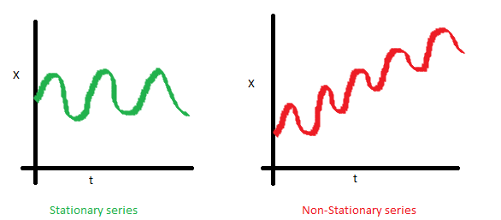
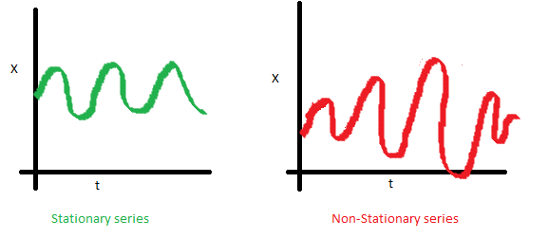
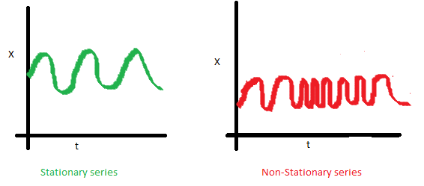
What is Stationary Data
Notes:
A stationary time series is one whose statistical properties such as mean, variance, autocorrelation, etc. are all constant over time. Most statistical forecasting methods are based on the assumption that the time series can be rendered approximately stationary (i.e., “stationarized”) through the use of mathematical transformations.

Slide 4
Time Series Algorithms
Must have the ability to extrapolate patterns outside of the domain of training data. Time series attempts to project into the future – which can make things VERY different.
Another important property of a time series algorithm is the ability to derive confidence intervals. Confidence intervals can be estimated, but they may not be as accurate.
Notes:
One of the most important properties an algorithm needs in order to be considered a time-series algorithm is the ability to extrapolate patterns outside of the domain of training data. Many machine learning algorithms do not have this capability, as they tend to be restricted to a domain that is defined by training data. Therefore, they are not suited for time series, as the objective of time series is to project into the future.
Another important property of a time series algorithm is the ability to derive confidence intervals. While this is a default property of time series models, most machine learning models do not have this ability because they are not all based on statistical distributions. Confidence intervals can be estimated, but they may not be as accurate.

Slide 5
Differences from Machine Learning
Features must be handled with care
There may be smaller datasets
A different algorithmic approach is required (but use one for baseline!)
Both evaluation metrics and residuals diagnostics are used
The right resolution must be chosen
Provide confidence intervals on top of predictions
Some models will have either high accuracy or high error
Notes:
https://www.datascience.com/blog/time-series-forecasting-machine-learning-differences
FEATURES
Building the model to decide which factors to test and ultimately include or exclude, is a process called feature engineering.
This does not mean that features are completely off limits. Instead, they should be used with care because of the following reasons:
It is not clear what the future real values will be for those features.
If the features are predictable, i.e., they have some patterns, you can build a forecast model for each of them. However, keep in mind that using predicted values as features will propagate the error to the target variable, which may cause higher errors or produce biased forecasts.
A pure time series model may have similar or even better performance than one using features.
--------------
SMALL DATASETS
Not always a bad thing, but places obvious limits
--------------
DIFFERENT APPROACH
The usual ML algorithms won’t work here
--------------
EVALUATION
The most common evaluation metrics for forecasting are RMSE, which you may have used on regression problems; MAPE, as it is scale-independent and represents the ratio of error to actual values as a percent; and MASE, which indicates how well the forecast performs compared to a naïve average forecast.
--------------
RESOLUTION
While working with time series, you must have a clear understanding of the objective of your analysis. Assume that the business objective is to forecast at a yearly level. There are two technical ways you can approach this:
Use the yearly totals and fit a model to forecast the required number of years.
In the case that you have the values available at a quarterly or monthly level, build a time series model to forecast the required months or quarters, and aggregate to find the total per year.
Aim for the most granular level possible. When using aggregates, the model is learning patterns at a macro level. This not a bad choice, but there may be some patterns at the granular level that the model is not paying attention to. Like in our example, using monthly or quarterly data may yield better results than a yearly forecast.
There is another benefit from doing this as well. You may think that after adding the forecasts the error may propagate to the total. However, it is the opposite case. If the model you built is unbiased, the mean of the residuals will be zero or close to zero, and therefore the sum of the residuals will be close to zero
--------------
CONFIDENCE INTERVALS
As previously stated, forecasts are predictions that always include confidence intervals, usually 80% and 95%. Alternatively, you could choose to use the standard deviation of the residuals as the sample standard deviation, allowing the confidence intervals to be calculated using an appropriate distribution, like the normal or exponential.
For some models, e.g., neural networks, which are not based on probability distributions, you can run simulations of the forecasts and calculate confidence intervals from the distribution of the simulations.
--------------
ACCURACY/ERROR
In comparison to other models, the performance of time-series forecasting may differ. Remember that you are assuming that past patterns are indicators of what may occur in the future, and therefore they get replicated or projected. This means that if patterns continue the way they are, your forecasts will be highly accurate.
However, if patterns change, either gradually or abruptly, the forecasts may deviate highly from actual results. There is a chance that “black swan” or “gray swan” events may occur.
This also implies these models must be retrained *often*

Slide 6
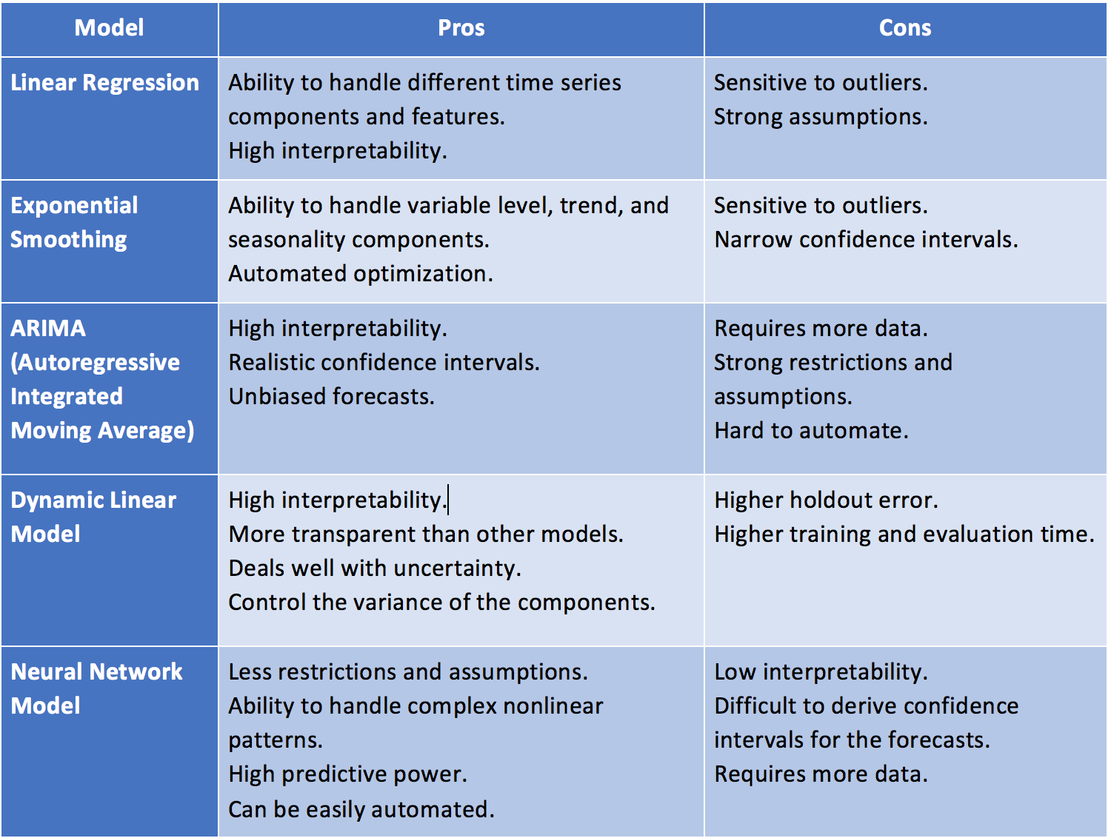
Time Series Models
Notes:
One of the most important properties an algorithm needs in order to be considered a time-series algorithm is the ability to extrapolate patterns outside of the domain of training data. Many machine learning algorithms do not have this capability, as they tend to be restricted to a domain that is defined by training data. Therefore, they are not suited for time series, as the objective of time series is to project into the future.
Another important property of a time series algorithm is the ability to derive confidence intervals. While this is a default property of time series models, most machine learning models do not have this ability because they are not all based on statistical distributions. Confidence intervals can be estimated, but they may not be as accurate.

Slide 7
Popular Time Series Models
ARIMA (Auto-Regressive Integrated Moving Average) -- An ARIMA model is fitted to time series data either to better understand the data or to predict future points in the series (forecasting).
GARCH (Generalized Auto-Regressive Conditional Heteroskedasticity) -- GARCH is an approach to estimate volatility in a time series data. Long Short Term Memory Neural Network
Long Short Term Memory networks – or LSTMs in short – are a special kind of Recurrent Neural Network, capable of learning long-term dependencies.
Dynamic Boltzmann Machine -- Dynamic Boltzmann Machine is a neural network which adds the functionality to model time dependencies between neural spikes in Boltzmann Machines. It was developed by IBM Research in Tokyo. A Boltzmann machine is a type of stochastic recurrent neural network (and Markov random field).
XGBoost -- XGBoost is an optimized distributed gradient boosting library designed to be highly efficient, flexible and portable. It implements machine learning algorithms under the Gradient Boosting framework.
Notes:
ARIMA – using auto-correlation (lags) as predictors
SARIMA – Seasonal ARIMA
GARCH – models changing variance

Slide 8
ARIMA Model
One of the most popular models
Assumes data is stationary (i.e. mean and variance should not vary over time)
Input data is univariate as opposed to multivariate
Auto ARIMA can make this very simple to use
Notes:
https://sciencing.com/similarities-of-univariate-multivariate-statistical-analysis-12549543.html
Univariate involves the analysis of a single variable while multivariate analysis examines two or more variables. Most multivariate analysis involves a dependent variable and multiple independent variables. Most univariate analysis emphasizes description while multivariate methods emphasize hypothesis testing and explanation.
Univariate time series: Only one variable is varying over time. For example, data collected from a sensor measuring the temperature of a room every second. Therefore, each second, you will only a one-dimensional value, which is the temperature.
Multivariate time series: Multiple variables are varying over time. For example, a tri-axial accelerometer. There are three accelerations, one for each axis (x,y,z) and they varying simultaneously over time.
Another example:
Multivariate time series is usually contrasted with univariate time series, where each observation at a time tis a vector of values instead of a single value. Typically for such series, the variables in the vector are closely interrelated, which is why we consider them to be single observation in vector form instead of distinct observations from separate time series.
To better explain the difference consider the following examples:
We want to monitor weight for a group of patients: This would be multiple time series, i.e. the daily weight values for each patient is a separate time series.
We want to monitor the health of a single patient, so we keep track of the patient's daily weight, daily body temperature, daily blood pressure, daily cholesterol levels, etc...: This would be a multivariate time series.
https://www.analyticsvidhya.com/blog/2018/08/auto-arima-time-series-modeling-python-r/
ARIMA has three components – AR (autoregressive term), I (differencing term) and MA (moving average term). Let us understand each of these components:
AR term refers to the past values used for forecasting the next value. The AR term is defined by the parameter ‘p’ in arima. The value of ‘p’ is determined using the PACF plot.
MA term is used to defines number of past forecast errors used to predict the future values. The parameter ‘q’ in arima represents the MA term. ACF plot is used to identify the correct ‘q’ value.
Order of differencing specifies the number of times the differencing operation is performed on series to make it stationary. Test like ADF and KPSS can be used to determine whether the series is stationary and help in identifying the d value.

Slide 9
Tuning Time Series models
Use a standard ML algorithm as baseline
Grid-search for hyperparameter tuning
Change data preparation methods
Walk-forward validation
Notes:
Using a standard ML as baseline helps check that the data isn’t just a random walk. If you can’t improve on this – it might be.
Walk-forward validation is the gold standard of model evaluation. It is the k-fold cross validation of the time series world.
Some data preparation schemes to consider include:
Differencing to remove a trend.
Seasonal differencing to remove seasonality.
Standardize to center.
Normalize to rescale.
Power Transform to make normal.

Slide 10


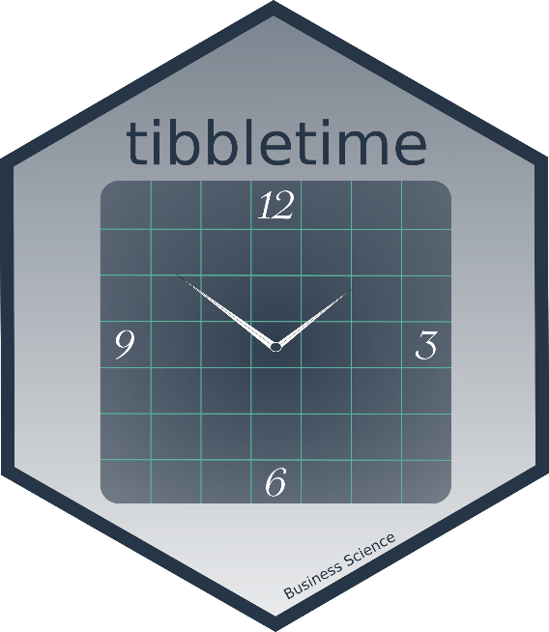


Open Source R Packages
NEW!!
Anomaly Detection
Most Popular
Financial Data
Stock/Portfolio
Analysis
Time-Aware
tibbles
(dplyr)
Helps Do Time-Based
Forecasting
w/ forecast
Time Series ML
Notes:
Matt Dancho
Founder & CEO, Business Science
business-science.io
Also CausalImpact, forecast and Facebook Prophet (R and Python)

